Slide 1
“Raya” conversational ai system
Title: Voice-Driven Conversational AI System Subtitle: Seamless Human-Computer Interaction
Team Name: fantastic four Tagline: “Empowering Through AI”

Slide 2
Problem statement & vision
Problem Statement: Create a system that converts spoken input into text, processes it with conversational AI, and delivers an audio response back to the user.
Real-World Implications:
Need for fast, natural human-computer interaction.
Current systems often lack accessibility.
Vision: To enable hands-free, intelligent, and accessible communication between humans and machines.

Slide 3
System architecture
Key Components:
Real-Time Processing
Context-Aware Conversations
Easy user interface

Slide 10
START
RESPONSE
INITIALIZES TEXT TO SPEECH
FLOW CONTROL
MATCH COMMAND TO ACTIONS
WAIT FOR THE COMMAND

Slide 11
KEY FEATURES & demo
Key Features:
Real-Time Performance: Fast speech-to-text and response generation.
Scalable: Works on web and mobile.
Demo Walkthrough Example:
User asks: “What’s the time now?”
STT: Converts speech to text.
NLP: Processes input and fetches weather data.
TTS: Plays: “The current time is 10:45 AM”

Slide 12
Future scope & conclusion
Future Scope:
Personalization with custom voice profiles.
Multi-modal interaction (e.g., speech + text).
Edge deployment for offline use.
Conclusion:
A scalable, cutting-edge solution to redefine human-machine interaction.

Slide 13
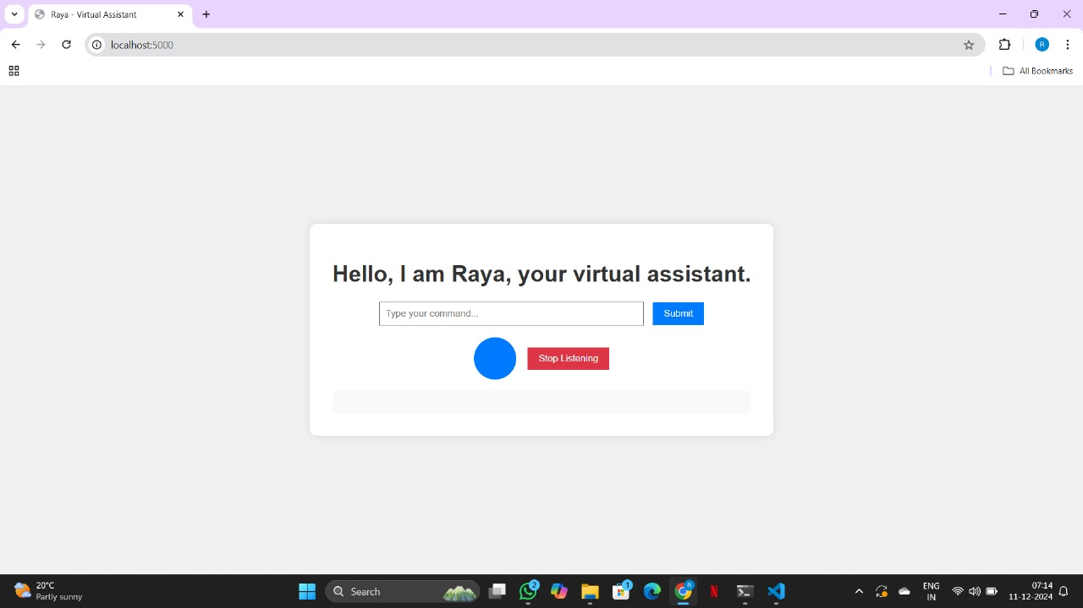
FINAL OUTCOMES - FRONTEND
Organizes files on desktop
Answers all “WH” questions
Time
Opens and closes files, apps
Date
Jokes
Plays on YouTube
Email automation

Slide 14
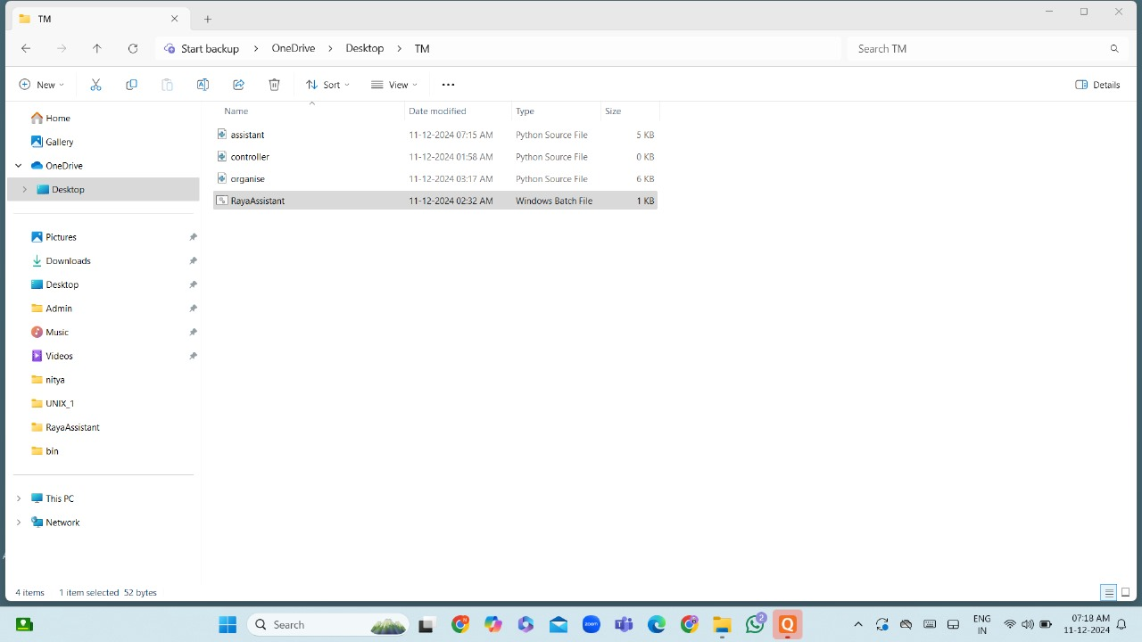
BATCH FILE
In a batch file, we will be running the code as a batch in the backend, in such a way that when we are working on our laptops, we won’t be interrupted by it , instead we will tell a command which will trigger it automatically.

Slide 15
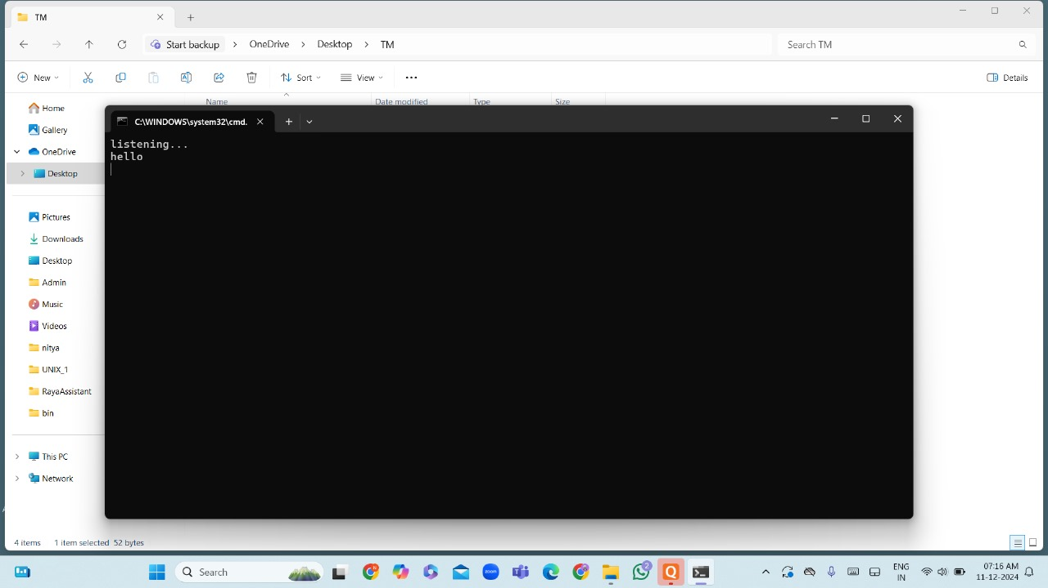
How the batch appears

